Slide 1

Chapter 4
E-environment
Part -2

Slide 2
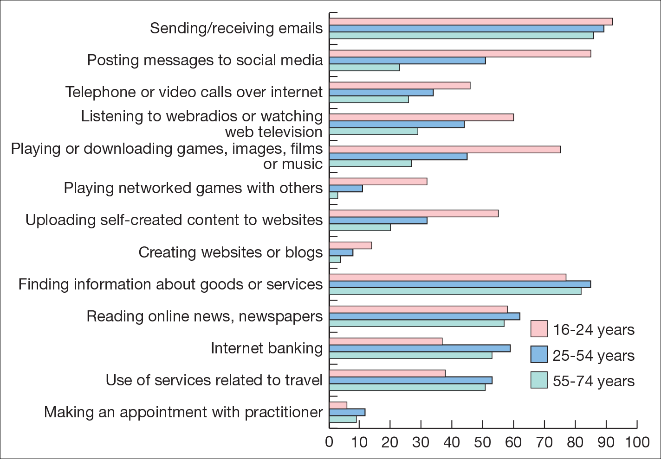
Applications of using the Internet Source: EuroStat (2012).

Slide 3
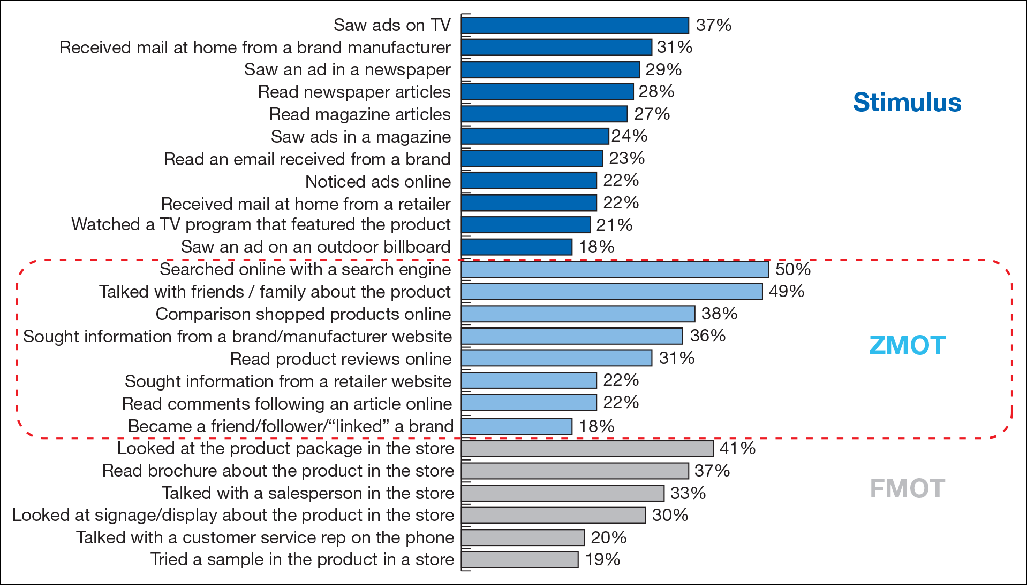
The influence of different information sources on purchase. ZMOT = Zero Moment of Truth (before visiting store), FMOT = First Moment of Truth (in‑store) Source: Google Shopper Sciences (2011).

Slide 4
Other Factors – Motivation for use of online services
Demographics help explain who is your buyer
Psychographic segmentation help explain why your consumer buys
Elements of psychographic segmentation include:
Occasion
Benefits sought
Usage rate
User status
Loyalty status
There are a number of different ways to gather data to help form the segmentation
Interviews, Surveys, Customer data

Slide 5
Other Factors – Motivating factors for using the web
The four motivating factors that cut across cultures are:
Research (information acquisition)
Communication (socialization)
Surfing (Entertainment)
Shopping

Slide 6
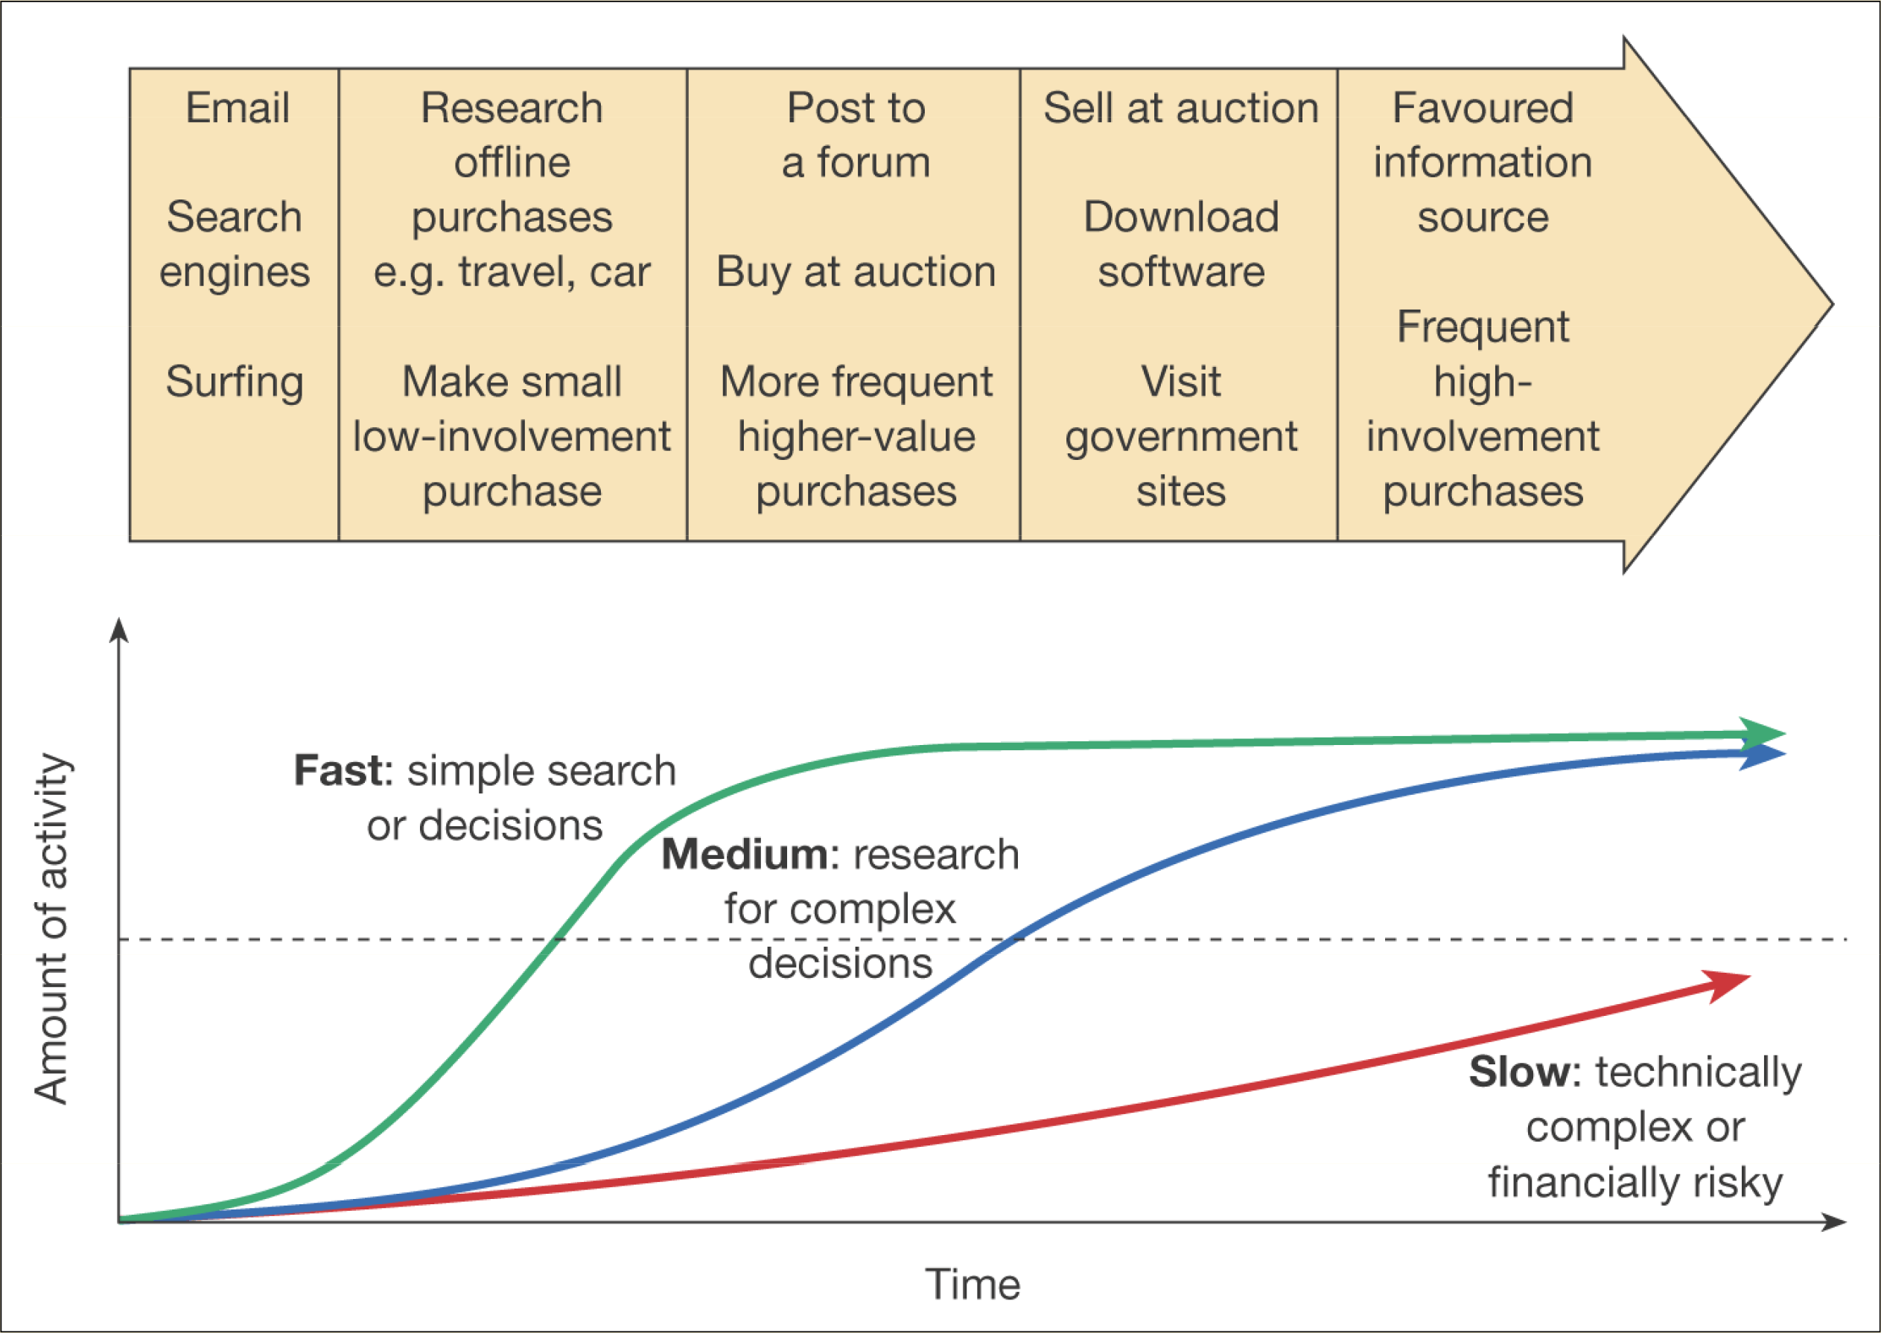
Figure 4.5 Development of experience in Internet usage

Slide 7
Business Demand for Digital Business Services
B2B market is more complex than B2C in that variation in demand will occur according to different types of organisation and people within the buying unit in the organisation.
Segmentation of different groups within a B2B target market
Variation in organisations characteristics
Size, industry sector and products, organisation type(private, public etc), Division, Country and region
Individual role
Role and responsibility, role in buying position, department, product interest, demographics, B2B profiles
Alibaba.com is one of the largest B2B marketplaces

Slide 8
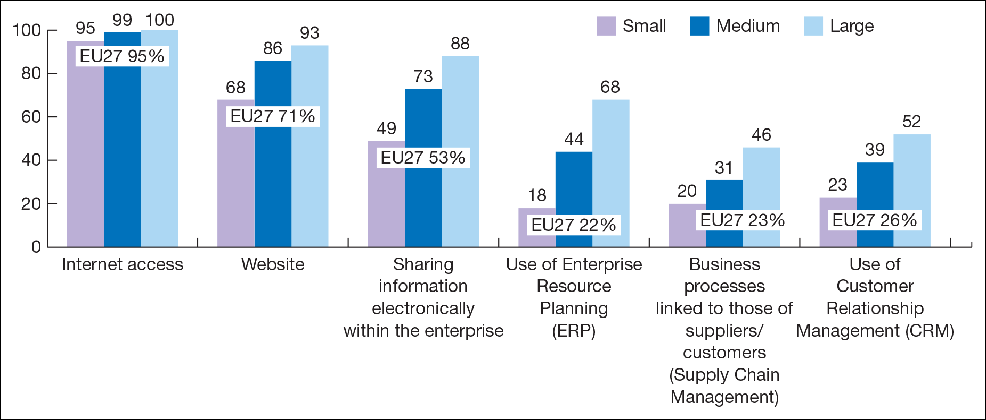
E-commerce sales across the EU
European Commission reviewed adoption of the digital business across Europe.
In 2016, 92% of EU enterprises (SME) made use of Internet.
The growth of the Internet usage, has made 77% of the enterprises in the EU gave importance to their visibility of the Internet.
Increased demand for specialist ICT skills and hard to fill vacancies.
Figure 4.6 Enterprises adopting technologies for digital business, by size class, EU27, 2012 Source: EuroStat (2013).

Slide 9
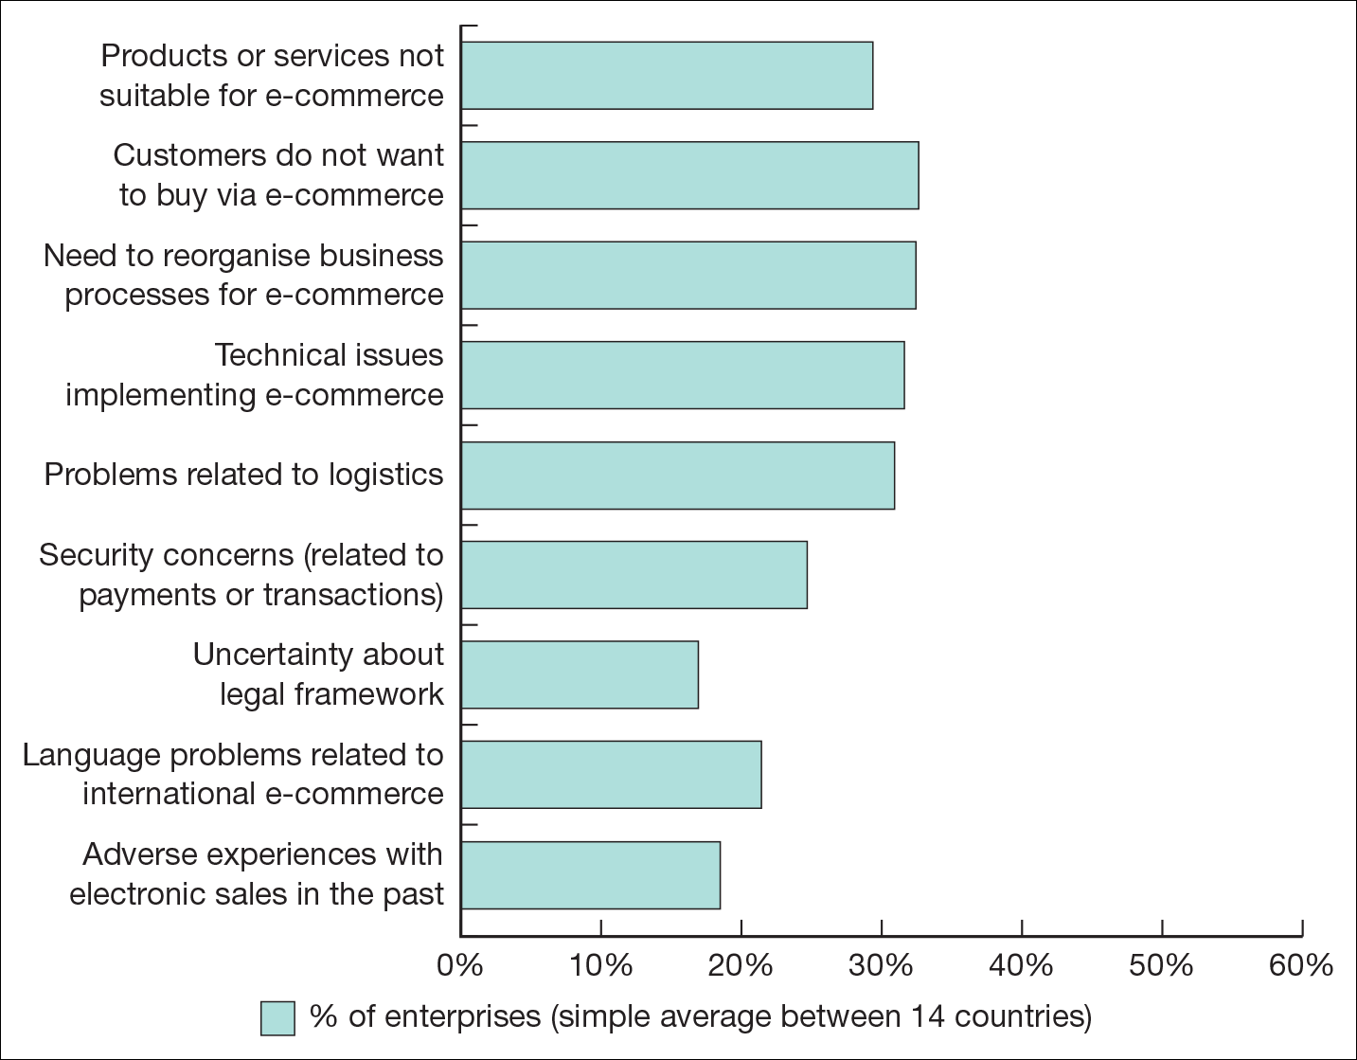
Figure 4.7 Barriers to adoption of e‑commerce services of European countries Source: European Commission (2010): http://ec.europa.eu/information_society/digitalagenda/documents/edcr.pdf. No longer available.

Slide 10
Privacy and Trust in e-commerce
Ethical standards are personal or business practices or behaviour generally considered acceptable by society.
Ethical issues and associated laws constitute an important consideration of the Internet business environment for marketers. Privacy is key of them
Privacy refers to a moral right of individuals to avoid intrusion into their personal affairs by third parties.

Slide 11
Ethical issues and data protection
Ethical issues concerned with personal information ownership have been usefully summarised by Mason (1986) into four areas:
Privacy – what information is held about the individual? (Ex:TalkTalk Cyber attack on 2015)
Accuracy – is it correct?
Property – who owns it and how can ownership be transferred?
Accessibility – who is allowed to access this information, and under which conditions?

Slide 12
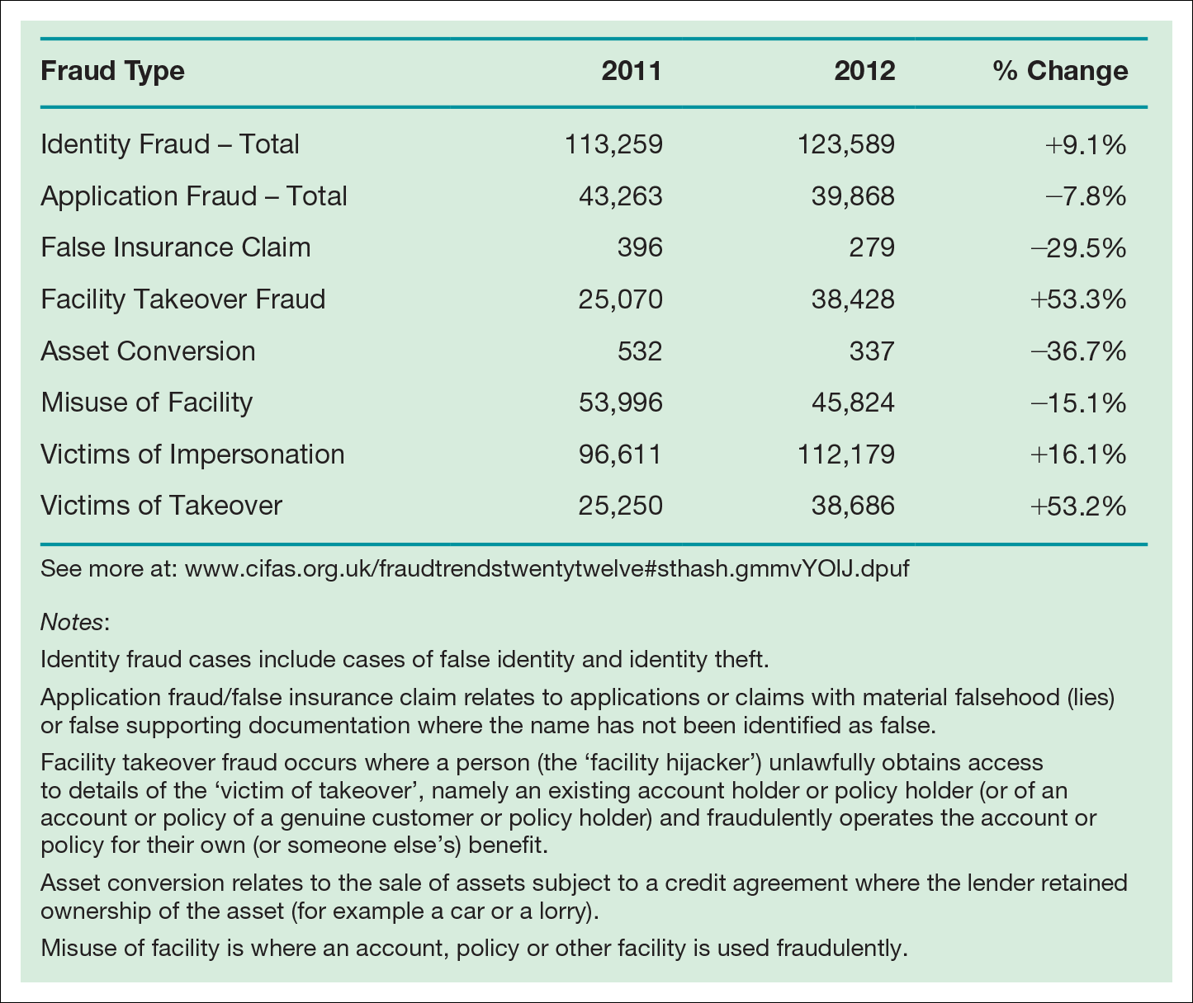
Table 4.3 Identity fraud categories in the UK Source: CIFAS (2013).
Notes:
Insert Table 4.5

Slide 13
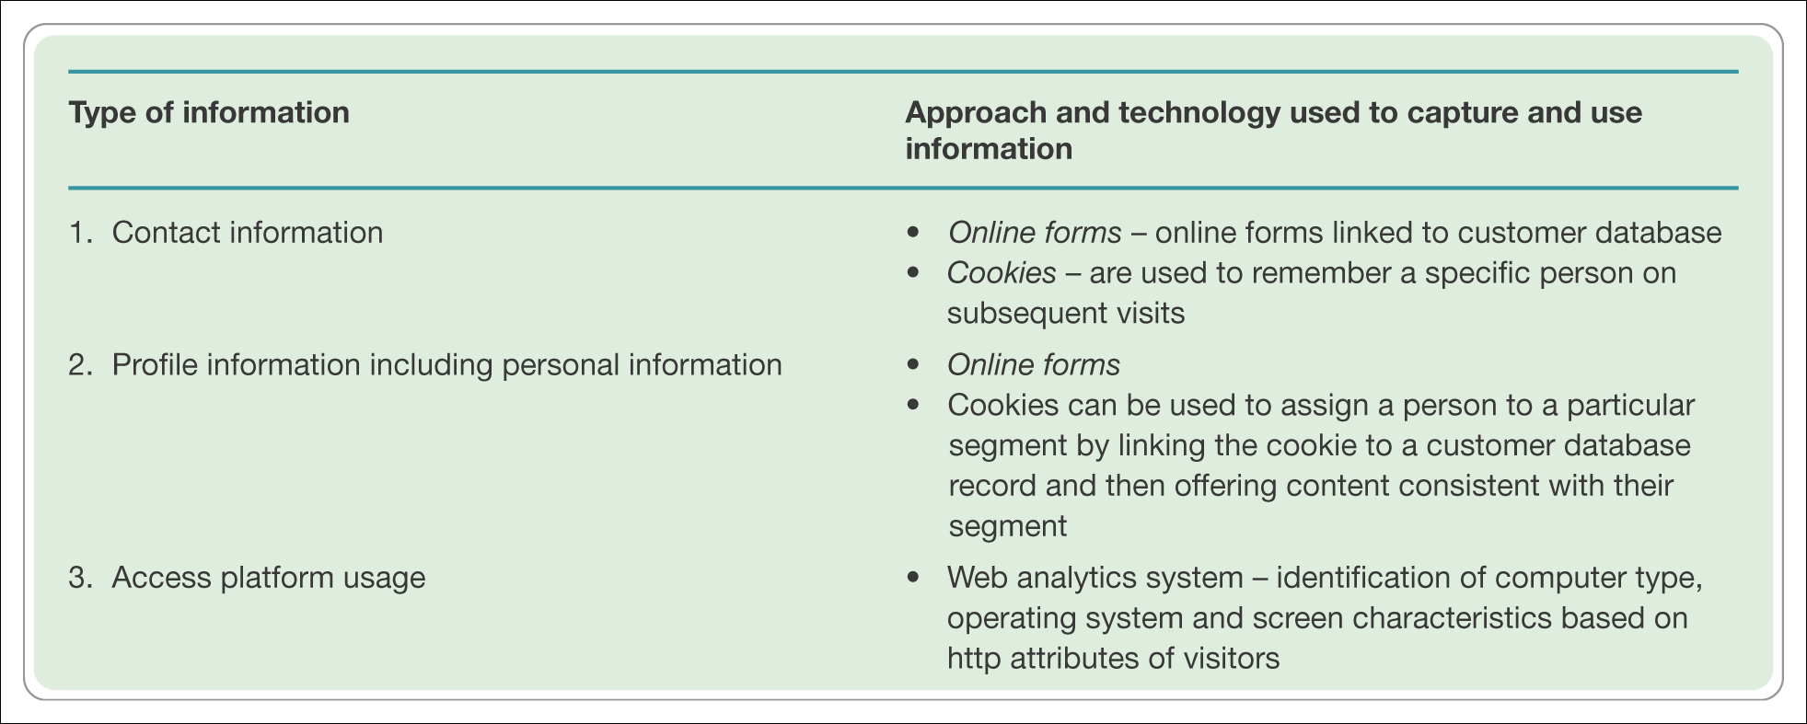
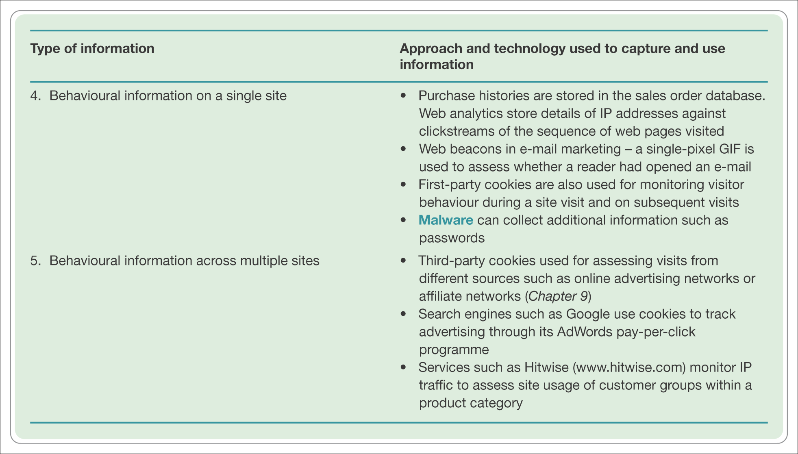
Table 4.4 Types of information collected online and related technologies

Slide 14
Ethics – Fletcher’s view
Fletcher (2001) provides an alternative perspective, raising these issues of concern for both the individual and the marketer:
Transparency – who is collecting what information?
2. Security – how is information protected once collected by a company?
3. Liability – who is responsible if data are abused?

Slide 15
The eight principles for data protection
Fairly and lawfully processed
Processed for limited purposes
Adequate, relevant and not excessive
Accurate
Not kept longer than necessary
Processed in accordance with the data subject’s rights
Secure
Not transferred to countries without adequate protection.

Slide 16
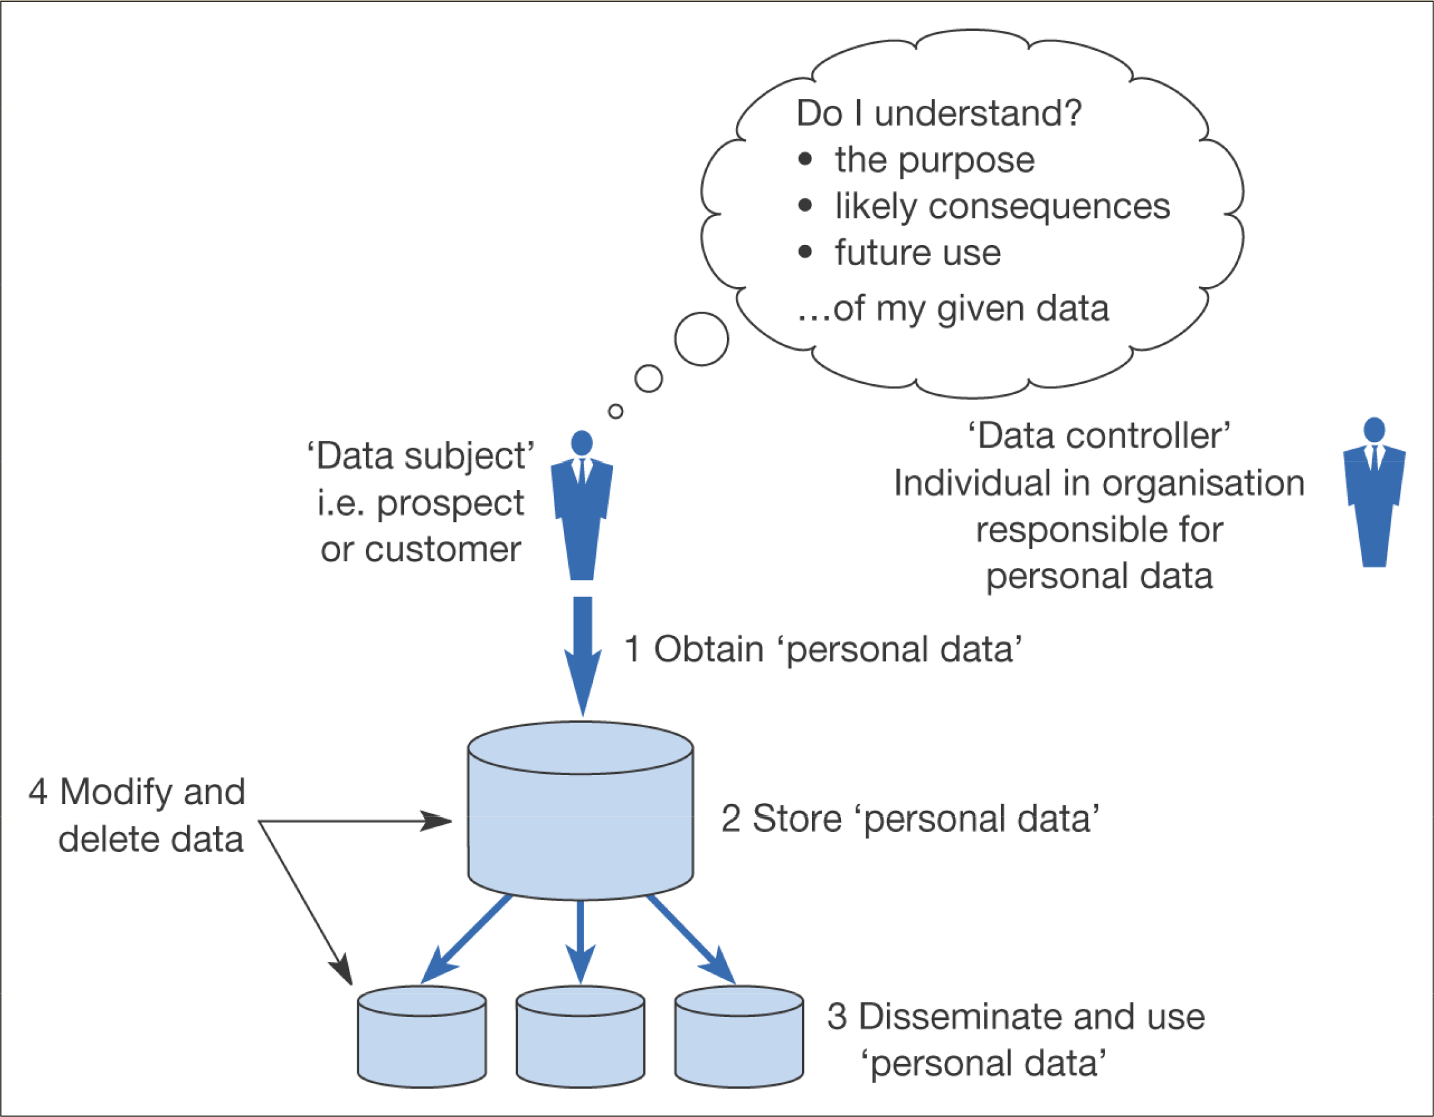
Figure 4.8 Information flows that need to be understood for compliance with data protection legislation

Slide 17
Localisation
Tailoring of web-site information for individual countries or regions is referred to as Localisation
Singh and Pereira (2005) provide an evaluation framework for the level of localisation:
Standardised websites (not localised). A single site serves all customer segments (domestic and international).
Semi-localised websites. A single site serves all customers; however, there will be contact information about foreign subsidiaries available for international customers. Many sites fall into this category.

Slide 18
Localisation (Continued)
Localised websites. Country-specific websites with language translation for international customers, wherever relevant. 3M (www.3m.com) has adapted the websites for many countries to local language versions. It initially focused on the major websites.
Highly localised websites. Country-specific websites with language translation; they also include other localisation efforts in terms of time, date, postcode, currency formats, etc. Dell (www.dell.com) provides highly localised websites.
Culturally customised websites. Websites reflecting complete ‘immersion’ in the culture of target customer segments; as such, targeting a particular country may mean providing multiple websites for that country depending on the dominant cultures present. Durex (www.durex.com) is a good example of a culturally customised website.

Slide 19
Economic/political
Ensuring companies competitiveness
Funding for education and technology
Promoting new technology for example, broadband 12% in UK, 70% Taiwan, South Korea
Achieving government efficiencies
E-government – all UK services online by 2005
Singapore ‘Intelligent Island’
Taxation regimes
Legislation for offshore trading.

Slide 20
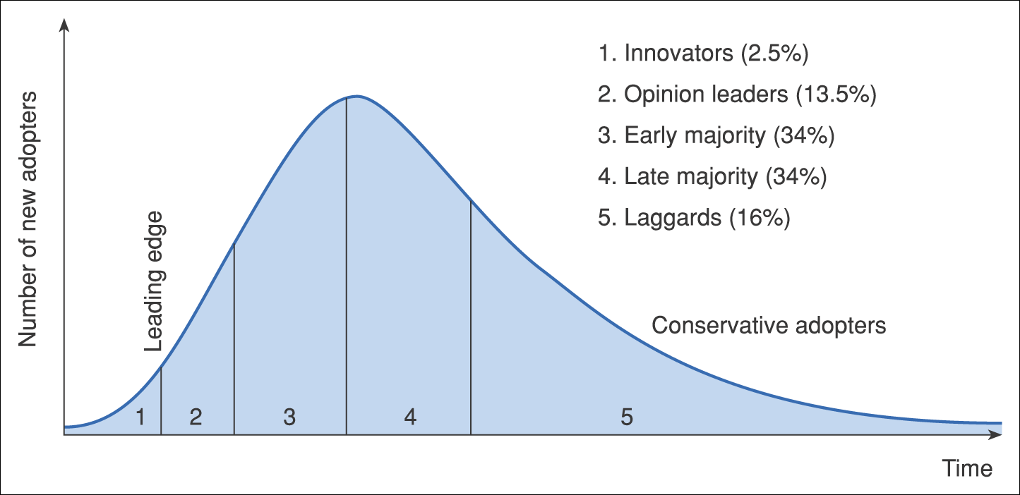
Figure 4.12 Diffusion–adoption curve of a Gartner hype cycle

Slide 21
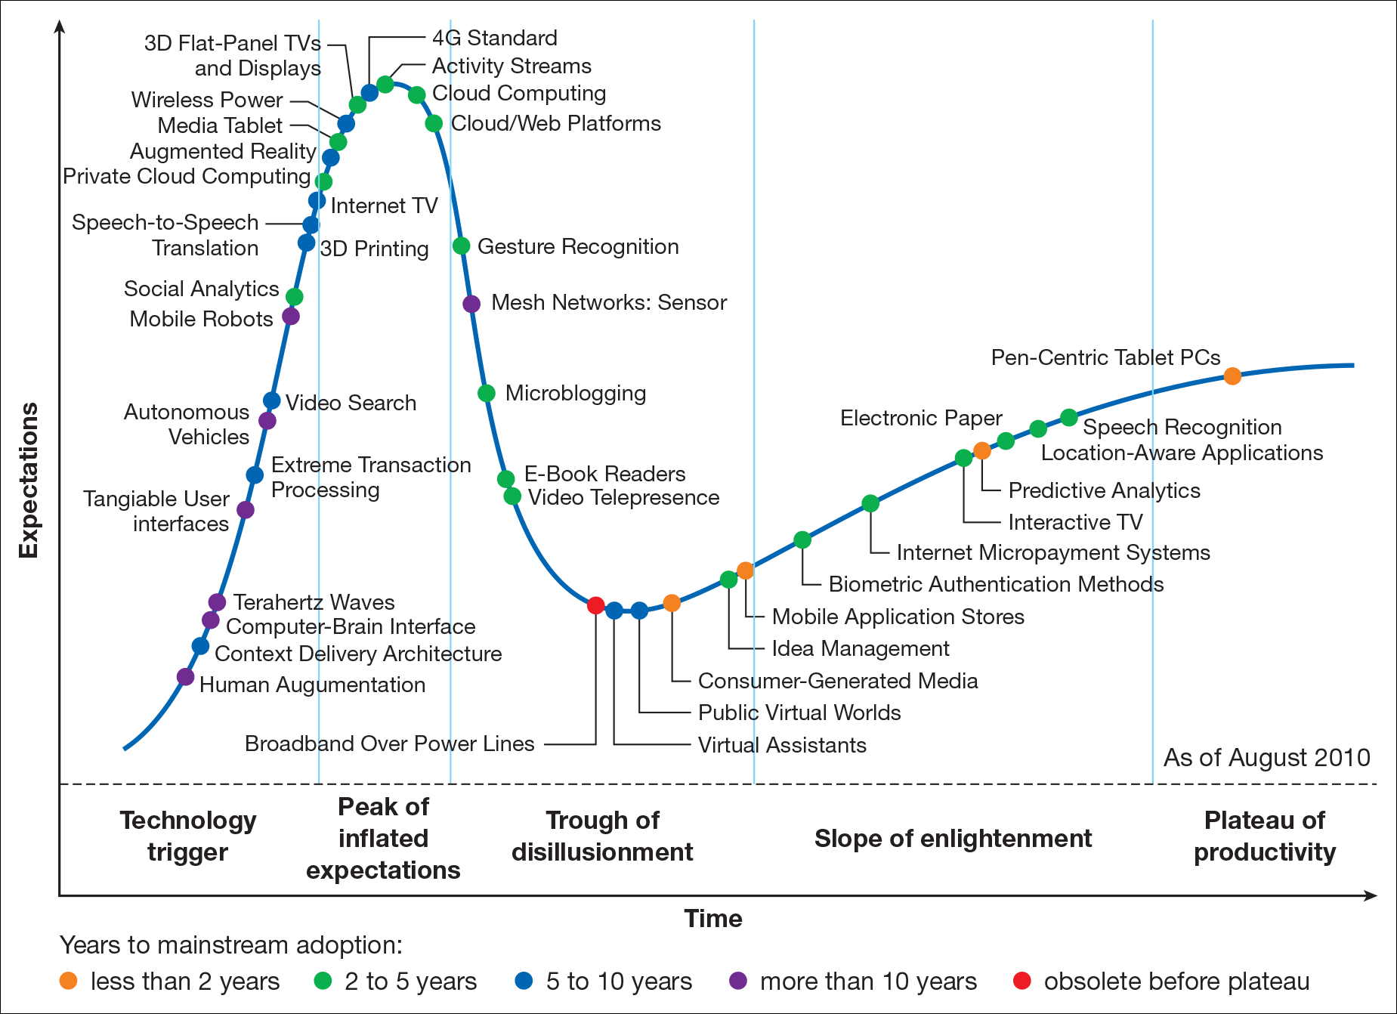
Technology trigger:
First phase, or breakthrough that generates significant press and interest
Peak of inflated expectations:
A frenzy of publicity generated over-enthusiasm and unrealistic expectations.
Trough of disillusionment:
They fail to meet expectations and quickly become unfashionable, consequently abandoned.
Slope of enlightenment:
Some companies still continue through and experiment to understand the benefits and practical application of the technology
Plateau of productivity:
Technology becomes increasingly stable as it become widely demonstrated and accepted.
Figure 4.13 Example of a Gartner hype cycle
Source: Gartner (2010).
Notes:
Replace with 4.13

Slide 22
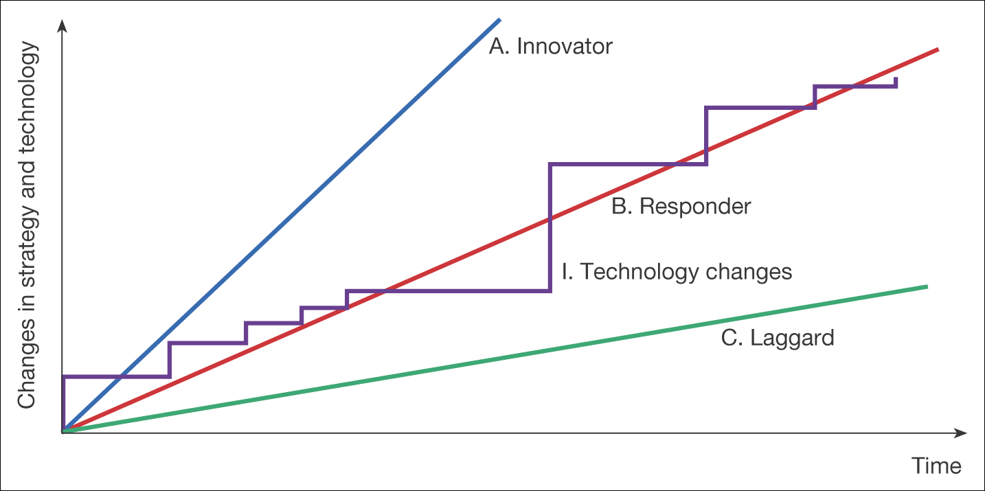
Figure 4.15 Alternative responses to changes in technology
The stepped curve I shows the variations in technology through time. Some may be small increments such as a new operating system.
Line A is a company that is using innovative business techniques, that adopts technology early.
Line C shows conservative adopter whose use of technology lags behind the available potential.
Line B shows the middle ground, where a company monitors new ideas as early adopters trial them and then adopts those that will have a positive impact on the business

Slide 23
In summary - What we covered?
It is very important and essential to understand and analyse the environment that the business is going to set up.
E-environment
Macro and Micro environment
SLEPT factors
Legal, Privacy and Ethical Constraints

